Slide 1
Chapter 5
The Working Cell

Slide 2
Harnessing Cellular Structures
Cells control their chemical environment using
energy,
enzymes, and
the plasma membrane원형질막.
Energy is defined as the capacity to cause change.
Conservation of Energy is a principle.
Kinetic energy운동에너지 is the energy of motion.
Potential energy위치에너지 is stored energy, energy that an object has because of its location or structure.
Life depends on countless similar conversions of energy from one form to another.
Notes:
2

Slide 3
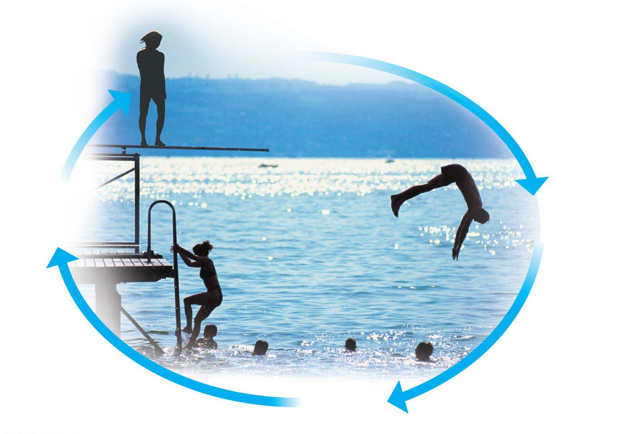
Figure 5.1
Greatest
potential
energy
Climbing
converts kinetic
energy to
potential energy.
Diving converts
potential
energy to
kinetic energy.
Least
potential
energy
Notes:
Figure 5.1 Energy conversions during a dive

Slide 4
Heat
Heat is a type of kinetic energy contained in the random motion of atoms and molecules.
All energy conversions generate some heat.
Entropy is a measure of disorder, or randomness, in a system.
Every time energy is converted from one form to another, entropy increases.
Notes:
4
Student Misconceptions and Concerns
1. Students with limited exposure to physics may have never understood the concepts of “energy” and “the conservation of energy” or distinguished between potential and kinetic energy. Understanding such broad and new abstract concepts requires time and concrete examples.
2. Although typically familiar with the concept of dietary Calories, students often struggle to think of Calories as a source of potential energy. For many students, it is not immediately clear how energy is stored in food.
Teaching Tips
1. Some students can relate well to the concept of entropy as it relates to the room where they live. Despite cleaning up and organizing the room on a regular (or irregular) basis, the room increasingly becomes disorganized, a victim of entropy, until another energy input (or effort) is exerted to make the room more orderly again. Students might even get to know “entropy” as the “dorm room effect.”
2. All too often we hear or read that some thing or reaction creates energy. We might hear or read that a power plant “produces” energy or that mitochondria “make” energy. Even in our classroom conversations, we may occasionally slip into this error. When discussing the first law of thermodynamics, consider emphasizing the inaccuracy of such statements.
3. The heat produced by the engine of a car is typically used to heat the car during cold weather. But is this same heat available in warmer weather? Students are often unaware that their car “heater” works very well in the summer, too. Just as exercise can warm us when it is cold, the same extra heat is released when we exercise in warm conditions. A car engine in the summer struggles to dissipate heat in the same way that a human struggles to cool off after exercising when the weather is warm.
4. Here is a calculation that has impressed some students. Depending on the size and activity of a person, a human might burn 2,000 dietary Calories (kilocalories) a day. This is enough energy to raise the temperature of 20 L of liquid water from 0° to 100°C. This is something to think about the next time you heat water on the stove! If you can bring in ten 2-L bottles you can help students visualize how much liquid water can be raised from 0° to 100°C. (Note: 200 Calories raises about 2 L of water 100°C; but it takes much more energy to melt ice or to convert boiling water into steam.)
5. The same mass of fat (about 9 kcal per gram) stores nearly twice as many Calories as an equivalent mass of protein or carbohydrates (about 4.5–5 kcal per gram). Thus, when comparing equal masses of fat, protein, and lipid, the fat has nearly twice the potential energy. Fat is therefore an efficient way to store energy in animals and many plants. To store an equivalent amount of energy in the form of carbohydrates or proteins would require about twice the mass, adding a significant burden to the organism’s structure. (For example, if you were 20 pounds overweight, you would be nearly 40 pounds overweight if the same energy were stored as carbohydrates or proteins instead of fat.)
Active Lecture Tips
1. Challenge your students to come up with examples of common energy conversions in their lives. Have students turn to someone seated near them to find at least two examples. In our daily lives, we rely upon many energy transformations. On our classroom walls, a clock converts electrical energy to mechanical energy to sweep the hands around the clock’s face (unless it is digital!). Our physical (mechanical) activities walking to and from the classroom rely upon the chemical energy from our diet. This chemical energy in our diet also helps us maintain a steady body temperature (heat).
2. Challenge your students to explain why they feel warm when it is 30°C (86°F) outside if their core body temperature is 37°C (98.6°F). Shouldn’t they feel cold? Have students work in groups of two or three to think this through. The answer is that our bodies are always producing heat. At these higher temperatures, we are producing more heat than we need to maintain a core body temperature around 37°C. Thus, we sweat and behave in ways that help release our extra heat generated in cellular respiration.
3. See the Activity Keeping an Organized Dorm Room Requires Energy, Just Like in a Cell on the Instructor Exchange. Visit the Instructor Exchange in the MasteringBiology instructor resource area for a description of this activity.

Slide 5
Chemical Energy
The molecules of food, gasoline, and other fuels have a form of potential energy called chemical energy, which arises from the arrangement of atoms and can be released by a chemical reaction.
Living cells and automobile engines use the same basic process to make the chemical energy stored in their fuels available for work.
Cellular respiration세포호흡 is
the energy-releasing chemical breakdown of fuel molecules and
the storage of that energy in a form the cell can use to perform work.
Humans convert about 34% of our food energy to useful work.
The rest of the energy released by the breakdown of fuel molecules generates body heat.
Notes:
5
Student Misconceptions and Concerns
1. Students with limited exposure to physics may have never understood the concepts of “energy” and “the conservation of energy” or distinguished between potential and kinetic energy. Understanding such broad and new abstract concepts requires time and concrete examples.
2. Although typically familiar with the concept of dietary Calories, students often struggle to think of Calories as a source of potential energy. For many students, it is not immediately clear how energy is stored in food.
Teaching Tips
1. Some students can relate well to the concept of entropy as it relates to the room where they live. Despite cleaning up and organizing the room on a regular (or irregular) basis, the room increasingly becomes disorganized, a victim of entropy, until another energy input (or effort) is exerted to make the room more orderly again. Students might even get to know “entropy” as the “dorm room effect.”
2. All too often we hear or read that some thing or reaction creates energy. We might hear or read that a power plant “produces” energy or that mitochondria “make” energy. Even in our classroom conversations, we may occasionally slip into this error. When discussing the first law of thermodynamics, consider emphasizing the inaccuracy of such statements.
3. The heat produced by the engine of a car is typically used to heat the car during cold weather. But is this same heat available in warmer weather? Students are often unaware that their car “heater” works very well in the summer, too. Just as exercise can warm us when it is cold, the same extra heat is released when we exercise in warm conditions. A car engine in the summer struggles to dissipate heat in the same way that a human struggles to cool off after exercising when the weather is warm.
4. Here is a calculation that has impressed some students. Depending on the size and activity of a person, a human might burn 2,000 dietary Calories (kilocalories) a day. This is enough energy to raise the temperature of 20 L of liquid water from 0° to 100°C. This is something to think about the next time you heat water on the stove! If you can bring in ten 2-L bottles you can help students visualize how much liquid water can be raised from 0° to 100°C. (Note: 200 Calories raises about 2 L of water 100°C; but it takes much more energy to melt ice or to convert boiling water into steam.)
5. The same mass of fat (about 9 kcal per gram) stores nearly twice as many Calories as an equivalent mass of protein or carbohydrates (about 4.5–5 kcal per gram). Thus, when comparing equal masses of fat, protein, and lipid, the fat has nearly twice the potential energy. Fat is therefore an efficient way to store energy in animals and many plants. To store an equivalent amount of energy in the form of carbohydrates or proteins would require about twice the mass, adding a significant burden to the organism’s structure. (For example, if you were 20 pounds overweight, you would be nearly 40 pounds overweight if the same energy were stored as carbohydrates or proteins instead of fat.)
Active Lecture Tips
1. Challenge your students to come up with examples of common energy conversions in their lives. Have students turn to someone seated near them to find at least two examples. In our daily lives, we rely upon many energy transformations. On our classroom walls, a clock converts electrical energy to mechanical energy to sweep the hands around the clock’s face (unless it is digital!). Our physical (mechanical) activities walking to and from the classroom rely upon the chemical energy from our diet. This chemical energy in our diet also helps us maintain a steady body temperature (heat).
2. Challenge your students to explain why they feel warm when it is 30°C (86°F) outside if their core body temperature is 37°C (98.6°F). Shouldn’t they feel cold? Have students work in groups of two or three to think this through. The answer is that our bodies are always producing heat. At these higher temperatures, we are producing more heat than we need to maintain a core body temperature around 37°C. Thus, we sweat and behave in ways that help release our extra heat generated in cellular respiration.
3. See the Activity Keeping an Organized Dorm Room Requires Energy, Just Like in a Cell on the Instructor Exchange. Visit the Instructor Exchange in the MasteringBiology instructor resource area for a description of this activity.

Slide 6
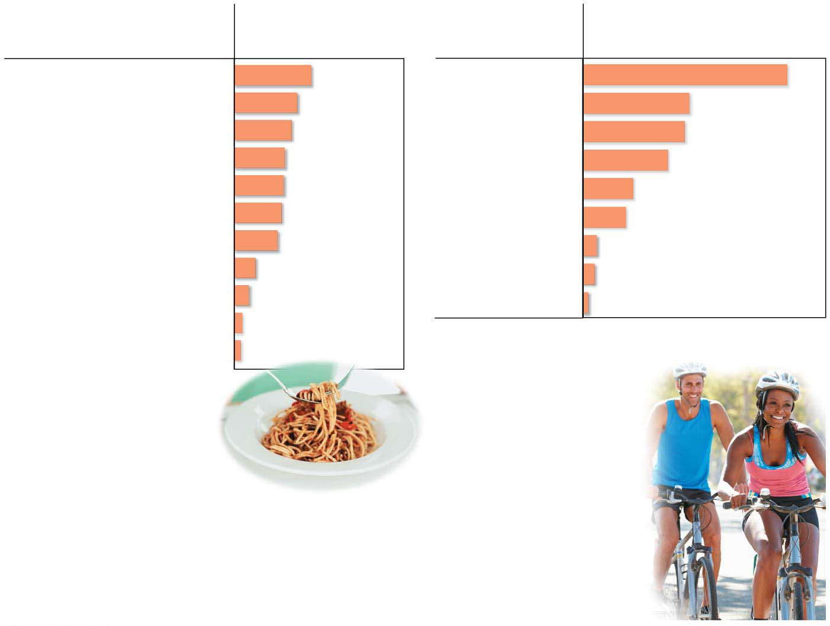
Figure 5.3
Food
Food Calories
Activity
Food Calories consumed per
hour by a 150-pound person*
Cheeseburger
295
Running (7 min/mi)
979
Spaghetti with sauce (1 cup)
241
Dancing (fast)
510
Baked potato (plain, with skin)
220
Bicycling (10 mph)
490
Fried chicken (drumstick)
193
Swimming (2 mph)
408
Bean burrito
189
Walking (3 mph)
245
Pizza with pepperoni (1 slice)
181
Dancing (slow)
204
Peanuts (1 ounce)
166
Playing the piano
73
Apple
81
Driving a car
61
Garden salad (2 cups)
56
Sitting (writing)
28
Popcorn (plain, 1 cup)
31
*Not including energy necessary for basic functions,
such as breathing and heartbeat
Broccoli (1 cup)
25
(a) Food Calories
(kilocalories) in
various foods
(b) Food Calories
(kilocalories) we burn
in various activities
A calorie (cal) is the amount of energy that can raise the temperature of 1 gram (g) of water by 1°C. Food Calories are kilocalories, equal to 1,000 calories.
Notes:
Figure 5.3 Some caloric accounting

Slide 7
Energy Transformations: ATP and Cellular Work
ATP, adenosine triphosphate
acts like an energy shuttle,
stores energy obtained from food, and
releases it later as needed.
Such energy transformations are essential for all life on Earth.
ATP energizes other molecules in cells by transferring phosphate groups to those molecules.
This energy
helps cells change shape,
enables the transport of ions and other dissolved substances across the membranes, and
drives the production of a cell’s large molecules.
Notes:
7
Student Misconceptions and Concerns
1. Although students might already understand mechanical and chemical work in a cell, the idea of transport work might be new to them. Chapter 6, in a section on the electron transport system, develops an analogy between transport work and water behind a dam. Therefore, at this point you might consider making an analogy between transport work (against a gradient) and pumping water up into a reservoir (against gravity)—perhaps into a water tower.
2. Energy shuttling at the cellular level may be new to many students, but it is a familiar concept when related to the use of money in our society. Students might be discouraged if the only benefit of work was the ability to make purchases from your employer. (Most of us would soon tire of a fast-food job that pays its employees only in free food!) Money permits the generation of value (a paycheck) analogous to an energy-releasing reaction to be coupled to an energy (money)-consuming reaction, making purchases in distant locations. This idea of “earn and spend” is a common concept most students know well.
Teaching Tips
1. The authors suggest an analogy between ATP and a spring. When a phosphate group is attached to ADP, it is like compressing the spring. When a phosphate group is lost, the spring is relaxed, and energy is released.
2. When introducing ATP and ADP, consider having students think of the terms as A-3-P and A-2-P, noting that the word roots “tri” means three and “di” means two. It might help students to keep track of the number of phosphates more easily.
3. Recycling is essential in cell biology. Damaged organelles are broken down intracellularly and the chemical components recycled, monomers of the cytoskeleton are routinely recycled, and ADP is recycled. Several advantages are common to both human recycling of components of garbage and cellular recycling. For example, both save energy by avoiding the need to remanufacture the basic units, and both avoid an accumulation of waste products that could interfere with other “environmental” chemistry (the environment of the cell or the environment of the human population).
Active Lecture Tips
1. See the Activity Universal Currency in the Cell on the Instructor Exchange. Visit the Instructor Exchange in the MasteringBiology instructor resource area for a description of this activity.

Slide 8
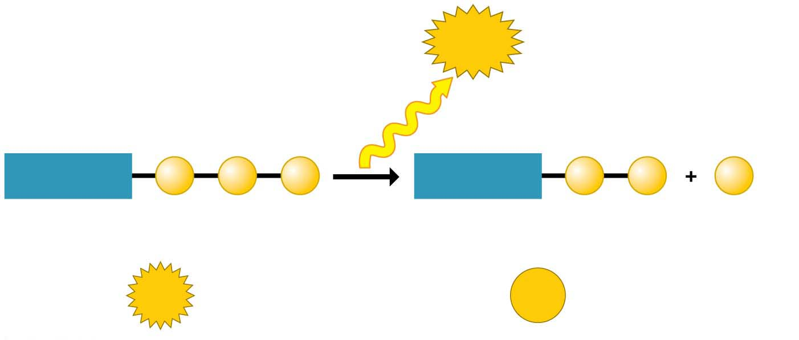
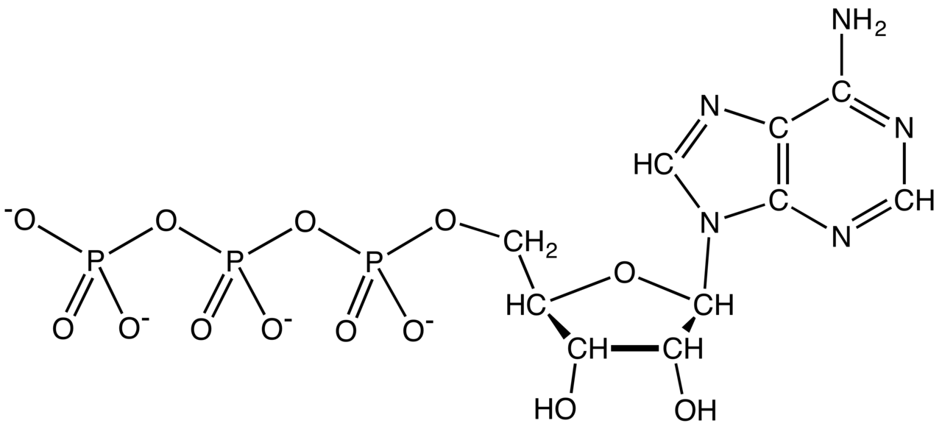
Figure 5.4
The release of the phosphate at the tip of the adenosine triphosphate삼인산 tail makes energy available to cells.
Energy
Triphosphate
Diphosphate
Adenosine
P
P
P
Adenosine
P
P
P
Phosphate
(transferred
to another
molecule)
ATP
ADP
Notes:
Figure 5.4 ATP power

Slide 9
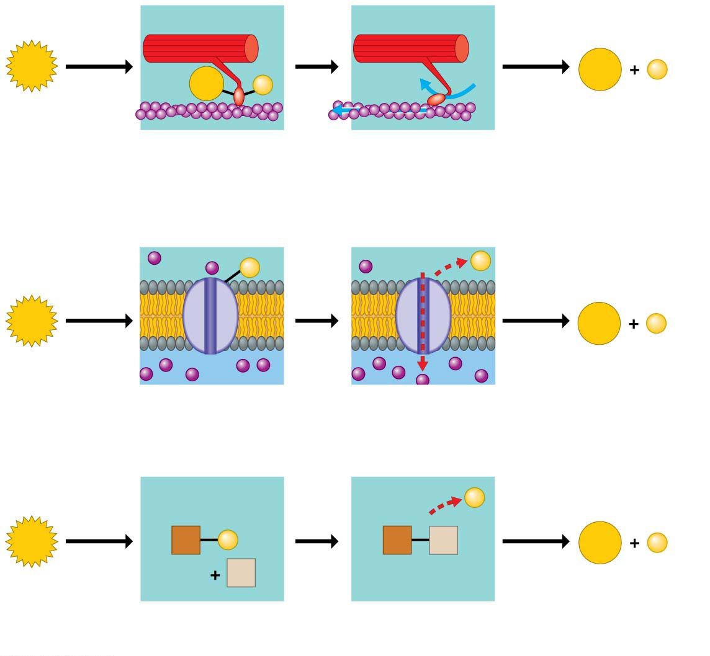
Figure 5.5
Motor
protein
ATP
ADP
P
ADP
P
Protein moved
(a) Motor protein performing mechanical work (moving a muscle fiber)
Transport
protein
Solute
P
P
ATP
ADP
P
Solute transported
(b) Transport protein수송단백질 performing transport work (importing a solute)
P
ATP
X
P
X
Y
ADP
P
Y
Reactants
Product made
(c) Chemical reactants performing chemical work (promoting a chemical reaction)
Notes:
Figure 5.5 How ATP drives cellular work

Slide 10
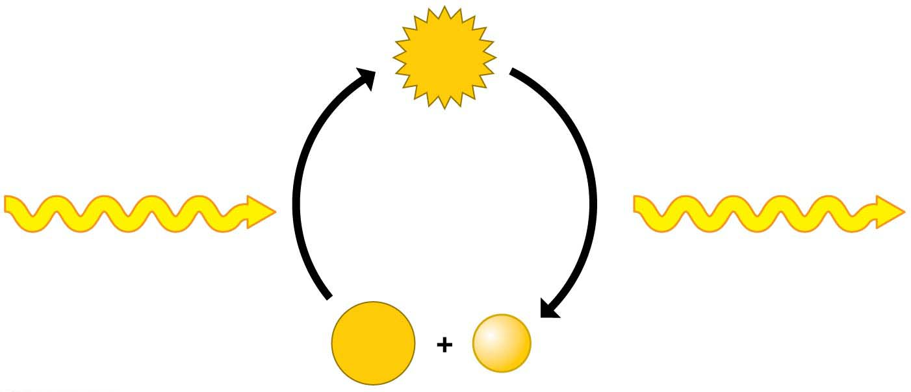
The ATP Cycle
Cells spend ATP continuously.
Cellular work spends ATP, which is recycled when ADP and phosphate are combined, using energy released by cellular respiration.
Up to 10 million ATPs are consumed and recycled each second in a working muscle cell.
ATP
Energy for
cellular work
Cellular respiration:
chemical energy
harvested from
fuel molecules
ADP
Notes:
10
Student Misconceptions and Concerns
1. Although students might already understand mechanical and chemical work in a cell, the idea of transport work might be new to them. Chapter 6, in a section on the electron transport system, develops an analogy between transport work and water behind a dam. Therefore, at this point you might consider making an analogy between transport work (against a gradient) and pumping water up into a reservoir (against gravity)—perhaps into a water tower.
2. Energy shuttling at the cellular level may be new to many students, but it is a familiar concept when related to the use of money in our society. Students might be discouraged if the only benefit of work was the ability to make purchases from your employer. (Most of us would soon tire of a fast-food job that pays its employees only in free food!) Money permits the generation of value (a paycheck) analogous to an energy-releasing reaction to be coupled to an energy (money)-consuming reaction, making purchases in distant locations. This idea of “earn and spend” is a common concept most students know well.
Teaching Tips
1. The authors suggest an analogy between ATP and a spring. When a phosphate group is attached to ADP, it is like compressing the spring. When a phosphate group is lost, the spring is relaxed, and energy is released.
2. When introducing ATP and ADP, consider having students think of the terms as A-3-P and A-2-P, noting that the word roots “tri” means three and “di” means two. It might help students to keep track of the number of phosphates more easily.
3. Recycling is essential in cell biology. Damaged organelles are broken down intracellularly and the chemical components recycled, monomers of the cytoskeleton are routinely recycled, and ADP is recycled. Several advantages are common to both human recycling of components of garbage and cellular recycling. For example, both save energy by avoiding the need to remanufacture the basic units, and both avoid an accumulation of waste products that could interfere with other “environmental” chemistry (the environment of the cell or the environment of the human population).
Active Lecture Tips
1. See the Activity Universal Currency in the Cell on the Instructor Exchange. Visit the Instructor Exchange in the MasteringBiology instructor resource area for a description of this activity.

Slide 11
Enzymes
Metabolism물질대사 is the total of all chemical reactions in an organism.
Most metabolic reactions require the assistance of enzymes효소, proteins that speed up chemical reactions without being consumed by the reaction.
All living cells contain thousands of different enzymes, each promoting a different chemical reaction.
Notes:
11
Student Misconceptions and Concerns
1. For students not previously familiar with activation energy, analogies can make all the difference. Activation energy can be thought of as a small input that is needed to trigger a large output. This is like (a) an irritated person who needs only a bit more frustration to explode in anger, (b) small waves that lift debris over a dam, or (c) lighting a match around lighter fluid. In each situation, the output was much greater than the input.
2. The specific interactions of enzymes and substrates can be illustrated with simple physical models. Many students new to these concepts will benefit from several forms of explanation, including diagrams such as those in the textbook, physical models, and the opportunity to manipulate or create their own examples. New concepts, like pitching a tent, are best constructed with many lines of support.
Teaching Tips
1. The text notes that the relationship between an enzyme and its substrate is like a handshake, with each hand generally conforming to the shape of the other. This induced fit is also like the change in shape of a glove when a hand is inserted. The glove’s general shape matches the hand, but the final “fit” requires some additional adjustments.
2. Enzyme inhibitors that block the active site are like (a) a person sitting in your assigned theater seat or (b) a car parked in your parking space. Analogies for inhibitors that change the shape of the active site are more difficult to imagine. Consider challenging your students to think of such analogies. (Perhaps someone adjusting the driver seat of the car differently from your preferences and then leaving it that way when you try to use the car.)
3. Consider challenging your class to suggest advantages to using specific enzyme inhibitors as insect poisons. Many advantages exist and include (a) the ability to target chemical reactions of only certain types of pest organisms and (b) the ability to target chemical reactions that are found in insects but not in humans.
4. The information in DNA is used to direct the production of RNA, which in turn directs the production of proteins. Yet in Chapter 3, four different types of biological molecules were noted as significant components of life. Students who think this through might be curious, and you could point out that DNA does not directly control the production of carbohydrates and lipids. So how does DNA exert its influence over the synthesis of these two chemical groups? The answer is largely by way of enzymes, which are proteins with the ability to control the production of carbohydrates and lipids.
Active Lecture Tips
1. Feedback regulation relies on the negative feedback of the accumulation of a product. Ask students in class to work in pairs to suggest other products of reactions that inhibit the process that made them, when the product reaches high enough levels. (Gas station pumps routinely shut off when a high level of gasoline is detected. Furnaces typically turn off when enough heat has been produced, and toilets stop running when the tank is refilled.)
2. See the Activity Students, Design Your Own Enzyme-Catalyzed Reaction on the Instructor Exchange. Visit the Instructor Exchange in the MasteringBiology instructor resource area for a description of this activity.
3. See the Activity Lock and Key Analogy with Enzymes on the Instructor Exchange. Visit the Instructor Exchange in the MasteringBiology instructor resource area for a description of this activity.

Slide 12
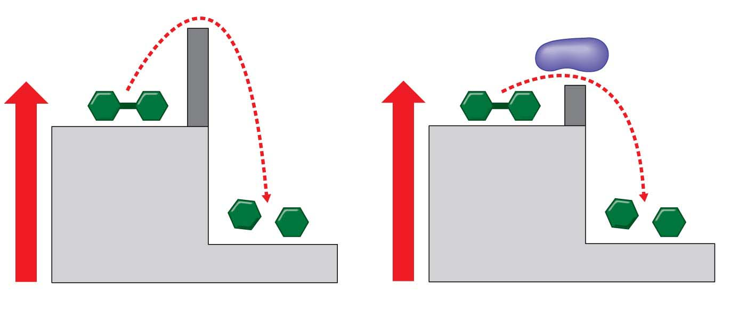
Figure 5.7
Activation
energy barrier
without enzyme
Reactant
Reactant
Enzyme
Activation
energy barrier
reduced by
enzyme
Products
Products
Energy
Energy
(a) Without enzyme
(b) With enzyme
Activation energy활성화 에너지 is the energy that must be invested to start a reaction, by activating the reactants and triggering a chemical reaction.
Enzymes enable metabolism to occur by reducing the amount of activation energy required to break the bonds of reactant molecules반응물질.
Notes:
Figure 5.7 Enzymes and activation energy

Slide 13
An enzyme is very selective in the reaction it catalyzes.
Each enzyme recognizes a substrate기질, a certain reactant molecule.
The active site활성화자리 has a shape and chemistry that fits the substrate molecule.
This interaction is called induced fit because the entry of the substrate induces the enzyme to change shape slightly, making the fit between the substrate and active site snugger.
After the products are released from the active site, the enzyme can accept another molecule of its substrate.
Many enzymes are named for their substrates, but with an –ase ending.
Notes:
13
Student Misconceptions and Concerns
1. For students not previously familiar with activation energy, analogies can make all the difference. Activation energy can be thought of as a small input that is needed to trigger a large output. This is like (a) an irritated person who needs only a bit more frustration to explode in anger, (b) small waves that lift debris over a dam, or (c) lighting a match around lighter fluid. In each situation, the output was much greater than the input.
2. The specific interactions of enzymes and substrates can be illustrated with simple physical models. Many students new to these concepts will benefit from several forms of explanation, including diagrams such as those in the textbook, physical models, and the opportunity to manipulate or create their own examples. New concepts, like pitching a tent, are best constructed with many lines of support.
Teaching Tips
1. The text notes that the relationship between an enzyme and its substrate is like a handshake, with each hand generally conforming to the shape of the other. This induced fit is also like the change in shape of a glove when a hand is inserted. The glove’s general shape matches the hand, but the final “fit” requires some additional adjustments.
2. Enzyme inhibitors that block the active site are like (a) a person sitting in your assigned theater seat or (b) a car parked in your parking space. Analogies for inhibitors that change the shape of the active site are more difficult to imagine. Consider challenging your students to think of such analogies. (Perhaps someone adjusting the driver seat of the car differently from your preferences and then leaving it that way when you try to use the car.)
3. Consider challenging your class to suggest advantages to using specific enzyme inhibitors as insect poisons. Many advantages exist and include (a) the ability to target chemical reactions of only certain types of pest organisms and (b) the ability to target chemical reactions that are found in insects but not in humans.
4. The information in DNA is used to direct the production of RNA, which in turn directs the production of proteins. Yet in Chapter 3, four different types of biological molecules were noted as significant components of life. Students who think this through might be curious, and you could point out that DNA does not directly control the production of carbohydrates and lipids. So how does DNA exert its influence over the synthesis of these two chemical groups? The answer is largely by way of enzymes, which are proteins with the ability to control the production of carbohydrates and lipids.
Active Lecture Tips
1. Feedback regulation relies on the negative feedback of the accumulation of a product. Ask students in class to work in pairs to suggest other products of reactions that inhibit the process that made them, when the product reaches high enough levels. (Gas station pumps routinely shut off when a high level of gasoline is detected. Furnaces typically turn off when enough heat has been produced, and toilets stop running when the tank is refilled.)
2. See the Activity Students, Design Your Own Enzyme-Catalyzed Reaction on the Instructor Exchange. Visit the Instructor Exchange in the MasteringBiology instructor resource area for a description of this activity.
3. See the Activity Lock and Key Analogy with Enzymes on the Instructor Exchange. Visit the Instructor Exchange in the MasteringBiology instructor resource area for a description of this activity.

Slide 14
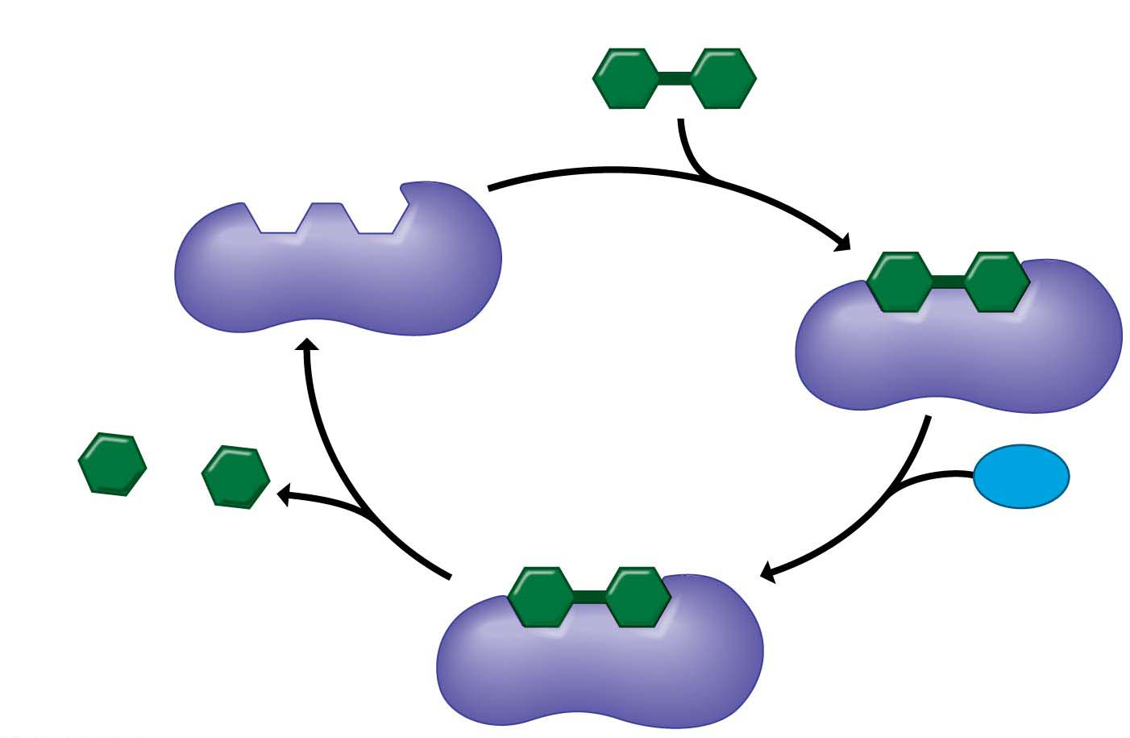
Figure 5.9-s4
1
Ready for
substrate
Substrate (lactose)
Active site
2
Substrate
binding
Enzyme
(lactase)
Galactose
H₂O
Glucose
4
Product
release
3
Catalysis
Notes:
Figure 5.9-s4 How an enzyme works (step 4)

Slide 15
Enzyme Inhibitors억제제
Certain molecules inhibit a metabolic reaction by
binding to an enzyme and
disrupting its function.
Some of these enzyme inhibitors are actually substrate imposters that plug up the active site.
Other inhibitors bind to the enzyme at a site remote from the active site, but the binding changes the enzyme’s shape so that the active site no longer accepts the substrate.
Notes:
15
Student Misconceptions and Concerns
1. For students not previously familiar with activation energy, analogies can make all the difference. Activation energy can be thought of as a small input that is needed to trigger a large output. This is like (a) an irritated person who needs only a bit more frustration to explode in anger, (b) small waves that lift debris over a dam, or (c) lighting a match around lighter fluid. In each situation, the output was much greater than the input.
2. The specific interactions of enzymes and substrates can be illustrated with simple physical models. Many students new to these concepts will benefit from several forms of explanation, including diagrams such as those in the textbook, physical models, and the opportunity to manipulate or create their own examples. New concepts, like pitching a tent, are best constructed with many lines of support.
Teaching Tips
1. The text notes that the relationship between an enzyme and its substrate is like a handshake, with each hand generally conforming to the shape of the other. This induced fit is also like the change in shape of a glove when a hand is inserted. The glove’s general shape matches the hand, but the final “fit” requires some additional adjustments.
2. Enzyme inhibitors that block the active site are like (a) a person sitting in your assigned theater seat or (b) a car parked in your parking space. Analogies for inhibitors that change the shape of the active site are more difficult to imagine. Consider challenging your students to think of such analogies. (Perhaps someone adjusting the driver seat of the car differently from your preferences and then leaving it that way when you try to use the car.)
3. Consider challenging your class to suggest advantages to using specific enzyme inhibitors as insect poisons. Many advantages exist and include (a) the ability to target chemical reactions of only certain types of pest organisms and (b) the ability to target chemical reactions that are found in insects but not in humans.
4. The information in DNA is used to direct the production of RNA, which in turn directs the production of proteins. Yet in Chapter 3, four different types of biological molecules were noted as significant components of life. Students who think this through might be curious, and you could point out that DNA does not directly control the production of carbohydrates and lipids. So how does DNA exert its influence over the synthesis of these two chemical groups? The answer is largely by way of enzymes, which are proteins with the ability to control the production of carbohydrates and lipids.
Active Lecture Tips
1. Feedback regulation relies on the negative feedback of the accumulation of a product. Ask students in class to work in pairs to suggest other products of reactions that inhibit the process that made them, when the product reaches high enough levels. (Gas station pumps routinely shut off when a high level of gasoline is detected. Furnaces typically turn off when enough heat has been produced, and toilets stop running when the tank is refilled.)
2. See the Activity Students, Design Your Own Enzyme-Catalyzed Reaction on the Instructor Exchange. Visit the Instructor Exchange in the MasteringBiology instructor resource area for a description of this activity.
3. See the Activity Lock and Key Analogy with Enzymes on the Instructor Exchange. Visit the Instructor Exchange in the MasteringBiology instructor resource area for a description of this activity.

Slide 16
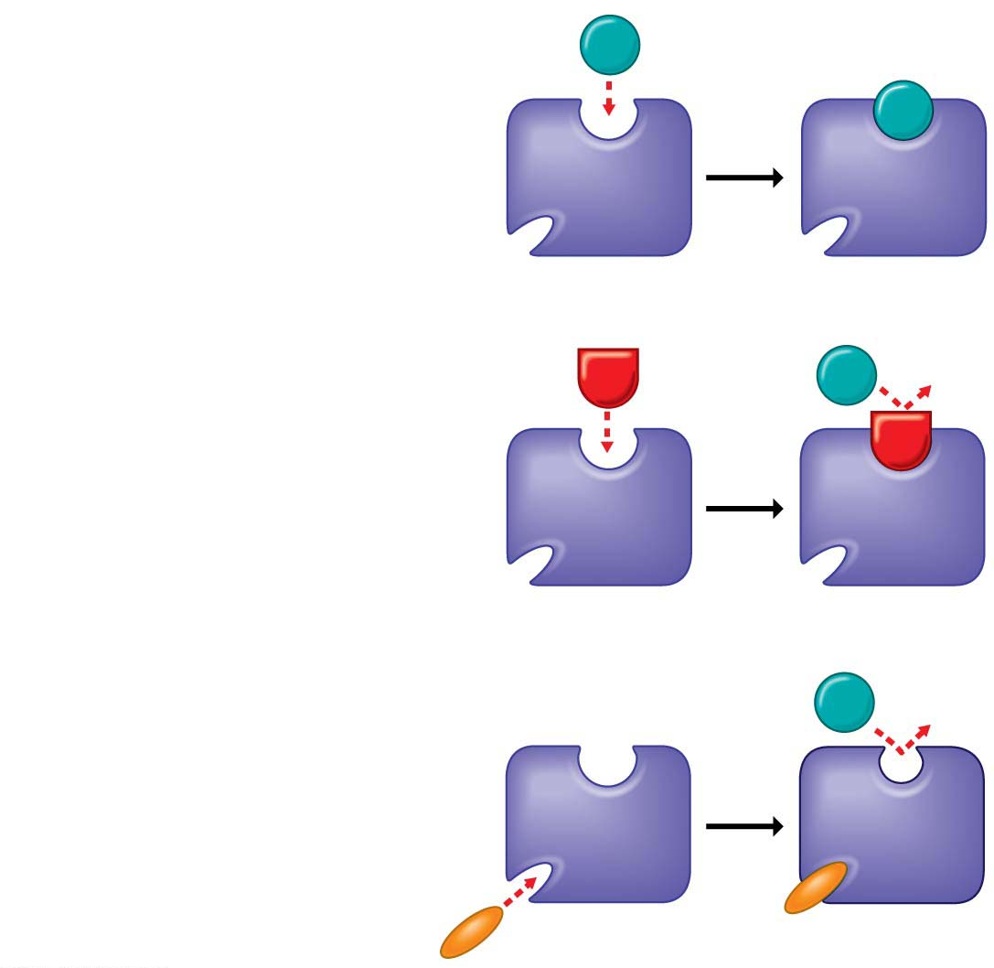
Figure 5.10
(a) Enzyme and substrate
binding normally
Substrate
Active site
Enzyme
(b) Enzyme inhibition by
a substrate imposter
Inhibitor
Substrate
Active site
Enzyme
(c) Inhibition of an enzyme
by a molecule that causes
the active site to change
shape
Substrate
Active site
Inhibitor
Enzyme
Notes:
Figure 5.10 Enzyme inhibitors

Slide 17
Many beneficial drugs work by inhibiting enzymes.
Penicillin blocks the active site of an enzyme that bacteria use in making cell walls.
Ibuprofen inhibits an enzyme involved in sending pain signals.
Many cancer drugs inhibit enzymes that promote cell division.
Many toxins and poisons also work as inhibitors.
Notes:
17
Student Misconceptions and Concerns
1. For students not previously familiar with activation energy, analogies can make all the difference. Activation energy can be thought of as a small input that is needed to trigger a large output. This is like (a) an irritated person who needs only a bit more frustration to explode in anger, (b) small waves that lift debris over a dam, or (c) lighting a match around lighter fluid. In each situation, the output was much greater than the input.
2. The specific interactions of enzymes and substrates can be illustrated with simple physical models. Many students new to these concepts will benefit from several forms of explanation, including diagrams such as those in the textbook, physical models, and the opportunity to manipulate or create their own examples. New concepts, like pitching a tent, are best constructed with many lines of support.
Teaching Tips
1. The text notes that the relationship between an enzyme and its substrate is like a handshake, with each hand generally conforming to the shape of the other. This induced fit is also like the change in shape of a glove when a hand is inserted. The glove’s general shape matches the hand, but the final “fit” requires some additional adjustments.
2. Enzyme inhibitors that block the active site are like (a) a person sitting in your assigned theater seat or (b) a car parked in your parking space. Analogies for inhibitors that change the shape of the active site are more difficult to imagine. Consider challenging your students to think of such analogies. (Perhaps someone adjusting the driver seat of the car differently from your preferences and then leaving it that way when you try to use the car.)
3. Consider challenging your class to suggest advantages to using specific enzyme inhibitors as insect poisons. Many advantages exist and include (a) the ability to target chemical reactions of only certain types of pest organisms and (b) the ability to target chemical reactions that are found in insects but not in humans.
4. The information in DNA is used to direct the production of RNA, which in turn directs the production of proteins. Yet in Chapter 3, four different types of biological molecules were noted as significant components of life. Students who think this through might be curious, and you could point out that DNA does not directly control the production of carbohydrates and lipids. So how does DNA exert its influence over the synthesis of these two chemical groups? The answer is largely by way of enzymes, which are proteins with the ability to control the production of carbohydrates and lipids.
Active Lecture Tips
1. Feedback regulation relies on the negative feedback of the accumulation of a product. Ask students in class to work in pairs to suggest other products of reactions that inhibit the process that made them, when the product reaches high enough levels. (Gas station pumps routinely shut off when a high level of gasoline is detected. Furnaces typically turn off when enough heat has been produced, and toilets stop running when the tank is refilled.)
2. See the Activity Students, Design Your Own Enzyme-Catalyzed Reaction on the Instructor Exchange. Visit the Instructor Exchange in the MasteringBiology instructor resource area for a description of this activity.
3. See the Activity Lock and Key Analogy with Enzymes on the Instructor Exchange. Visit the Instructor Exchange in the MasteringBiology instructor resource area for a description of this activity.

Slide 18
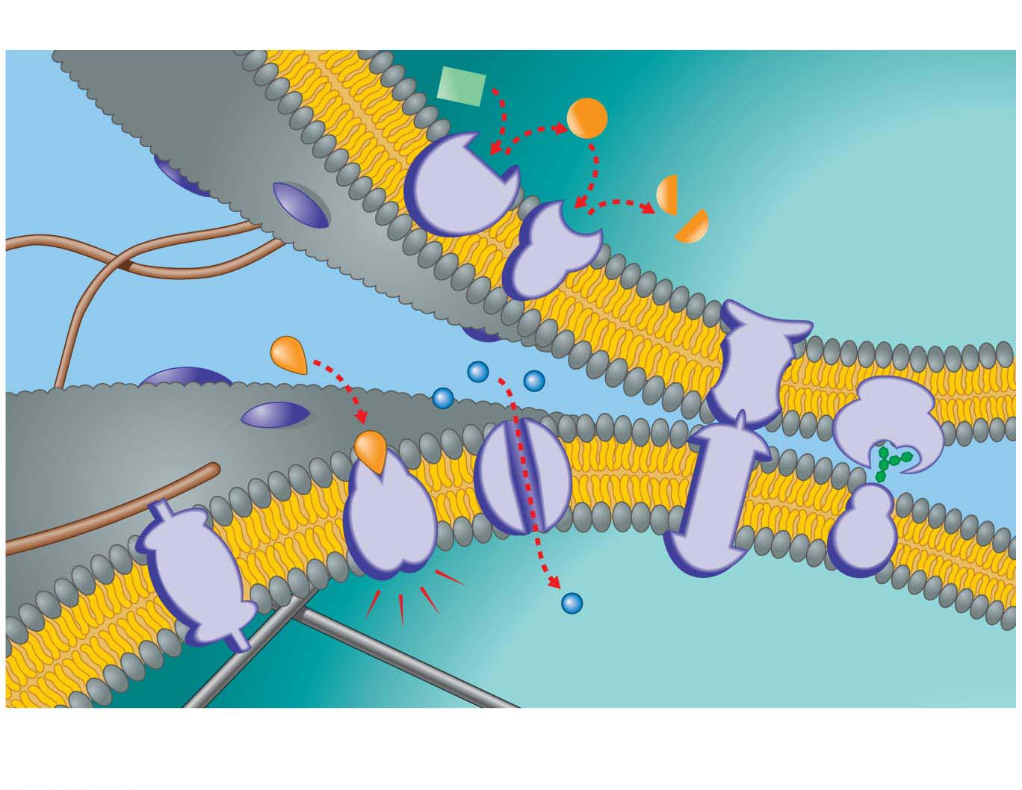
Membrane Function
Cells must also regulate the flow of materials to and from the environment.
The plasma membrane consists of a double layer (a phospholipid bilayer) with embedded proteins.
Major functions of membrane proteins.
Enzymatic activity
Fibers of extracellular matrix
Cytoplasm
Cell signaling
Attachment to the cytoskeleton
and extracellular matrix
Cell-cell
recognition
Transport
Cytoplasm
Intercellular
joining
Cytoskeleton
Notes:
18
Student Misconceptions and Concerns
1. For students with limited science backgrounds, concepts such as diffusion and osmosis can take considerable time to fully understand and apply. Instructors often struggle to remember a time in their lives when they did not know about such fundamental scientific principles. Consider spending extra time to illustrate and demonstrate these key processes to the class. Consider short interactive class exercises in which students create analogies or think of examples of these principles in their lives.
2. Students easily confuse the terms hypertonic and hypotonic. One challenge is to understand that these are relative terms, such as heavier, darker, or fewer. No single solution is “heavier,” no single cup of coffee is “darker,” and no single bag of M & M’s has “fewer” candies. Such terms only apply when comparing two or more items. A solution with a higher concentration is “hypertonic.” But the same solution might also be “hypotonic” to a third solution.
Teaching Tips
1. Students often benefit from reminders of diffusion in their lives. Smells can usually be traced back to their sources—the smell of dinner on the stove, the scent of a perfume or cologne coming from its bottle, the smoke drifting away from a campfire. These scents are strongest nearest the source and weaker as we move away.
2. The word root “hypo” means “below.” Thus, a hypodermic needle injects substances below the dermis. Students might best remember that hypotonic solutions have concentrations below that of the other solution(s).
3. After introducing the idea of hypertonic and hypotonic solutions, you may wish to challenge your students with the following: A marine salmon moves from the ocean up a freshwater stream to reproduce. The salmon is moving from a _____ environment to a _____ environment. (Answers: hypertonic; hypotonic)
4. Your students may have noticed that their fingers wrinkle after taking a long shower or bath or washing dishes. The skin wrinkles because it is swollen with water but still tacked down at some points. Oils inhibit the movement of water into our skin. Thus, soapy water results in wrinkling faster than plain water since the soap removes the natural layer of oil from our skin. Our skin is hypertonic to the solutions that produce the swelling that appears as large wrinkles.
5. The effects of hypertonic and hypotonic solutions are easily demonstrated if students soak carrot sticks, long slices of potato, or celery in hypertonic and hypotonic solutions. These also make nice class demonstrations.
6. The hydrophobic and hydrophilic ends of a phospholipid molecule create a lipid bilayer. The hydrophobic edges of the layer will also seal to other such edges, eventually wrapping a sheet into a sphere that can enclose water. Furthermore, because of these hydrophobic properties, lipid bilayers are naturally self-healing. All of these properties emerge from the structure of phospholipid.
Active Lecture Tips
1. Consider demonstrating simple diffusion. A large jar of water and a few drops of dark-colored dye work well over the course of a lecture period. Alternatively, release a strong scent of cologne or peppermint or peel part of an orange in the classroom and have students raise their hands as they first detect the smell. Students nearest the source will raise their hands before students farther away. A fan from a projector or overhead vent may bias the experiment a bit, so be aware of any directed movements of air in your classroom that might disrupt this demonstration.
2. See the Activity Using Food and Drink to Describe Osmosis on the Instructor Exchange. Visit the Instructor Exchange in the MasteringBiology instructor resource area for a description of this activity.
3. Students carefully considering exocytosis may notice that membrane from secretory vesicles is added to the plasma membrane. Challenge your students to work with someone sitting nearby to identify mechanisms that balance out this enlargement of the cell surface. (Endocytosis “subtracts” area from the cell surface. It is a major factor balancing out the additional membrane supplied by exocytosis.)

Slide 19
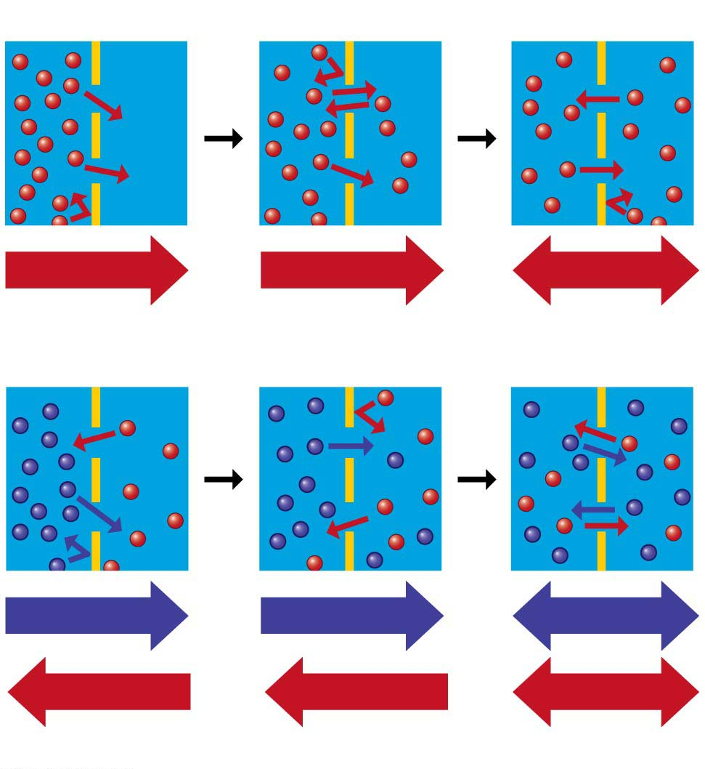
Figure 5.12
Passive Transport수동수송: Diffusion across Membranes
Molecules constantly vibrate and wander randomly.
Diffusion확산 is the movement of molecules spreading out evenly into the available space. A substance diffuses down its concentration gradient농도기울기 from where the substance is more concentrated to where it is less concentrated.
Net diffusion
Net diffusion
Equilibrium
Membrane
(a) Passive transport of one type of molecule
Net diffusion
Equilibrium
(b) Passive transport of two types of molecules
Net diffusion
Net diffusion
Notes:
Figure 5.12 Passive transport: diffusion across a membrane

Slide 20
Substances that do not cross membranes spontaneously, or otherwise cross very slowly, can be transported via proteins – transporter수송단백질 - that act as corridors for specific molecules.
This assisted transport is called facilitated diffusion촉진확산, a type of passive transport because it does not require the cell to expend energy.
Notes:
20
Student Misconceptions and Concerns
1. For students with limited science backgrounds, concepts such as diffusion and osmosis can take considerable time to fully understand and apply. Instructors often struggle to remember a time in their lives when they did not know about such fundamental scientific principles. Consider spending extra time to illustrate and demonstrate these key processes to the class. Consider short interactive class exercises in which students create analogies or think of examples of these principles in their lives.
2. Students easily confuse the terms hypertonic and hypotonic. One challenge is to understand that these are relative terms, such as heavier, darker, or fewer. No single solution is “heavier,” no single cup of coffee is “darker,” and no single bag of M & M’s has “fewer” candies. Such terms only apply when comparing two or more items. A solution with a higher concentration is “hypertonic.” But the same solution might also be “hypotonic” to a third solution.
Teaching Tips
1. Students often benefit from reminders of diffusion in their lives. Smells can usually be traced back to their sources—the smell of dinner on the stove, the scent of a perfume or cologne coming from its bottle, the smoke drifting away from a campfire. These scents are strongest nearest the source and weaker as we move away.
2. The word root “hypo” means “below.” Thus, a hypodermic needle injects substances below the dermis. Students might best remember that hypotonic solutions have concentrations below that of the other solution(s).
3. After introducing the idea of hypertonic and hypotonic solutions, you may wish to challenge your students with the following: A marine salmon moves from the ocean up a freshwater stream to reproduce. The salmon is moving from a _____ environment to a _____ environment. (Answers: hypertonic; hypotonic)
4. Your students may have noticed that their fingers wrinkle after taking a long shower or bath or washing dishes. The skin wrinkles because it is swollen with water but still tacked down at some points. Oils inhibit the movement of water into our skin. Thus, soapy water results in wrinkling faster than plain water since the soap removes the natural layer of oil from our skin. Our skin is hypertonic to the solutions that produce the swelling that appears as large wrinkles.
5. The effects of hypertonic and hypotonic solutions are easily demonstrated if students soak carrot sticks, long slices of potato, or celery in hypertonic and hypotonic solutions. These also make nice class demonstrations.
6. The hydrophobic and hydrophilic ends of a phospholipid molecule create a lipid bilayer. The hydrophobic edges of the layer will also seal to other such edges, eventually wrapping a sheet into a sphere that can enclose water. Furthermore, because of these hydrophobic properties, lipid bilayers are naturally self-healing. All of these properties emerge from the structure of phospholipid.
Active Lecture Tips
1. Consider demonstrating simple diffusion. A large jar of water and a few drops of dark-colored dye work well over the course of a lecture period. Alternatively, release a strong scent of cologne or peppermint or peel part of an orange in the classroom and have students raise their hands as they first detect the smell. Students nearest the source will raise their hands before students farther away. A fan from a projector or overhead vent may bias the experiment a bit, so be aware of any directed movements of air in your classroom that might disrupt this demonstration.
2. See the Activity Using Food and Drink to Describe Osmosis on the Instructor Exchange. Visit the Instructor Exchange in the MasteringBiology instructor resource area for a description of this activity.
3. Students carefully considering exocytosis may notice that membrane from secretory vesicles is added to the plasma membrane. Challenge your students to work with someone sitting nearby to identify mechanisms that balance out this enlargement of the cell surface. (Endocytosis “subtracts” area from the cell surface. It is a major factor balancing out the additional membrane supplied by exocytosis.)

Slide 21
Osmosis and Water Balance
The diffusion of water across a selectively permeable membrane is osmosis삼투.
A solute용질 is a substance that is dissolved in a liquid solvent, such as the salt in salt water, and the resulting mixture is called a solution.
The control of water balance is called osmoregulation삼투압조절.
Notes:
21
Student Misconceptions and Concerns
1. For students with limited science backgrounds, concepts such as diffusion and osmosis can take considerable time to fully understand and apply. Instructors often struggle to remember a time in their lives when they did not know about such fundamental scientific principles. Consider spending extra time to illustrate and demonstrate these key processes to the class. Consider short interactive class exercises in which students create analogies or think of examples of these principles in their lives.
2. Students easily confuse the terms hypertonic and hypotonic. One challenge is to understand that these are relative terms, such as heavier, darker, or fewer. No single solution is “heavier,” no single cup of coffee is “darker,” and no single bag of M & M’s has “fewer” candies. Such terms only apply when comparing two or more items. A solution with a higher concentration is “hypertonic.” But the same solution might also be “hypotonic” to a third solution.
Teaching Tips
1. Students often benefit from reminders of diffusion in their lives. Smells can usually be traced back to their sources—the smell of dinner on the stove, the scent of a perfume or cologne coming from its bottle, the smoke drifting away from a campfire. These scents are strongest nearest the source and weaker as we move away.
2. The word root “hypo” means “below.” Thus, a hypodermic needle injects substances below the dermis. Students might best remember that hypotonic solutions have concentrations below that of the other solution(s).
3. After introducing the idea of hypertonic and hypotonic solutions, you may wish to challenge your students with the following: A marine salmon moves from the ocean up a freshwater stream to reproduce. The salmon is moving from a _____ environment to a _____ environment. (Answers: hypertonic; hypotonic)
4. Your students may have noticed that their fingers wrinkle after taking a long shower or bath or washing dishes. The skin wrinkles because it is swollen with water but still tacked down at some points. Oils inhibit the movement of water into our skin. Thus, soapy water results in wrinkling faster than plain water since the soap removes the natural layer of oil from our skin. Our skin is hypertonic to the solutions that produce the swelling that appears as large wrinkles.
5. The effects of hypertonic and hypotonic solutions are easily demonstrated if students soak carrot sticks, long slices of potato, or celery in hypertonic and hypotonic solutions. These also make nice class demonstrations.
6. The hydrophobic and hydrophilic ends of a phospholipid molecule create a lipid bilayer. The hydrophobic edges of the layer will also seal to other such edges, eventually wrapping a sheet into a sphere that can enclose water. Furthermore, because of these hydrophobic properties, lipid bilayers are naturally self-healing. All of these properties emerge from the structure of phospholipid.
Active Lecture Tips
1. Consider demonstrating simple diffusion. A large jar of water and a few drops of dark-colored dye work well over the course of a lecture period. Alternatively, release a strong scent of cologne or peppermint or peel part of an orange in the classroom and have students raise their hands as they first detect the smell. Students nearest the source will raise their hands before students farther away. A fan from a projector or overhead vent may bias the experiment a bit, so be aware of any directed movements of air in your classroom that might disrupt this demonstration.
2. See the Activity Using Food and Drink to Describe Osmosis on the Instructor Exchange. Visit the Instructor Exchange in the MasteringBiology instructor resource area for a description of this activity.
3. Students carefully considering exocytosis may notice that membrane from secretory vesicles is added to the plasma membrane. Challenge your students to work with someone sitting nearby to identify mechanisms that balance out this enlargement of the cell surface. (Endocytosis “subtracts” area from the cell surface. It is a major factor balancing out the additional membrane supplied by exocytosis.)

Slide 22
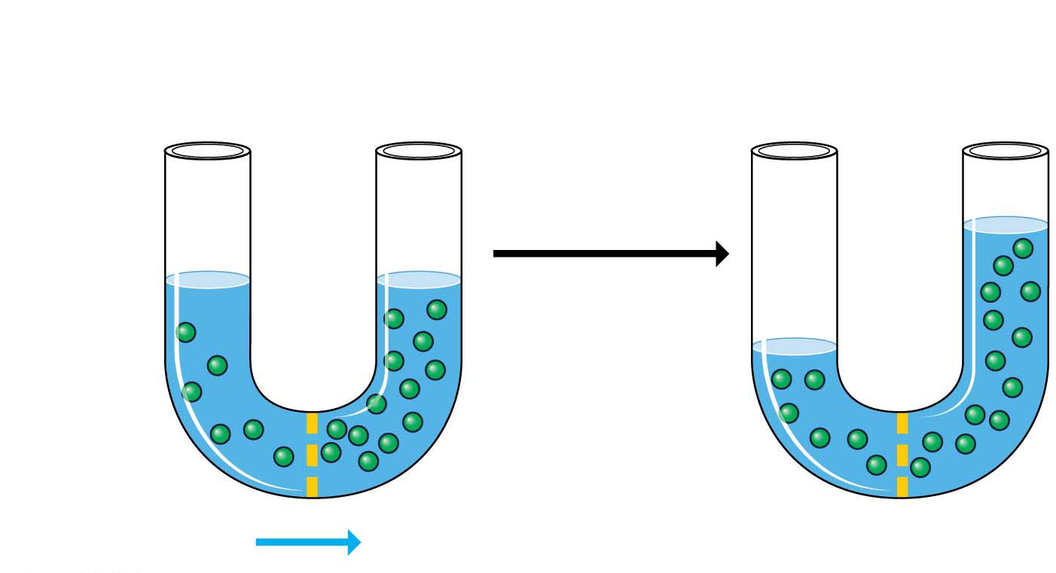
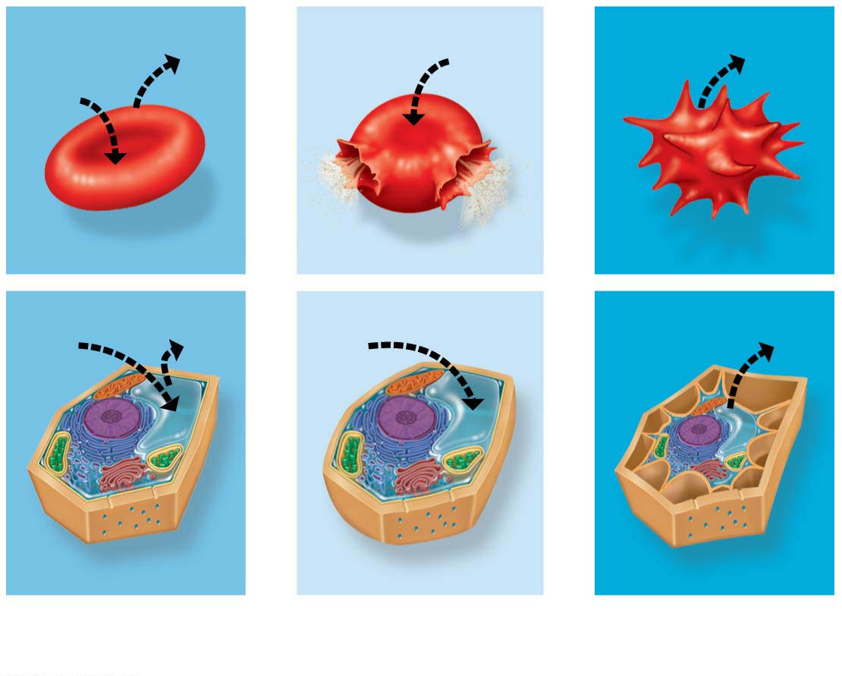
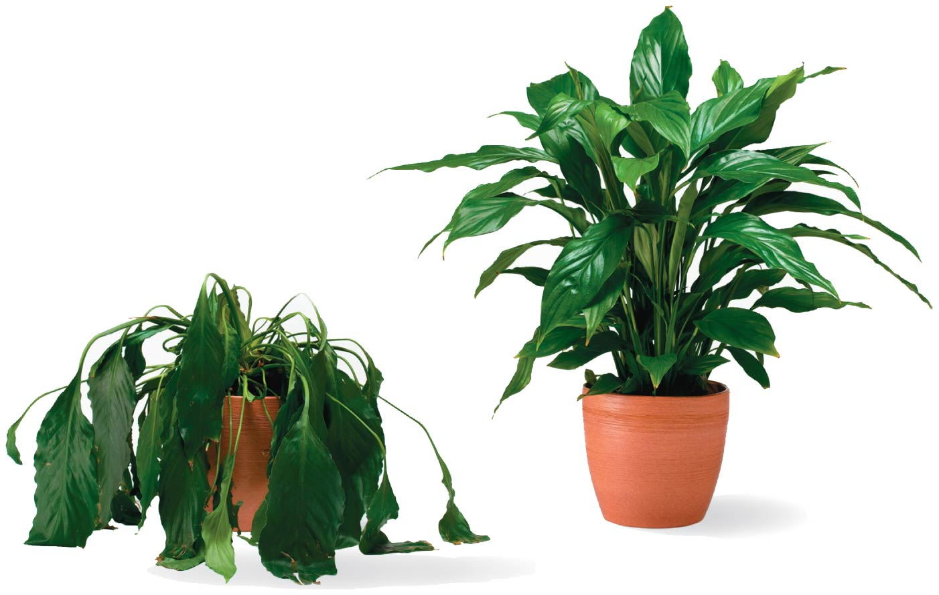
Figure 5.13-s2
Lower
concentration
(hypotonic)
Higher
concentration
(hypertonic)
Equal concentrations
(isotonic)
Osmosis
(net movement
of water)
Sugar
molecule
(solute)
Selectively
permeable
membrane
Animal cell
Plant cell
Notes:
Figure 5.13-s2 Osmosis (step 2)

Slide 23
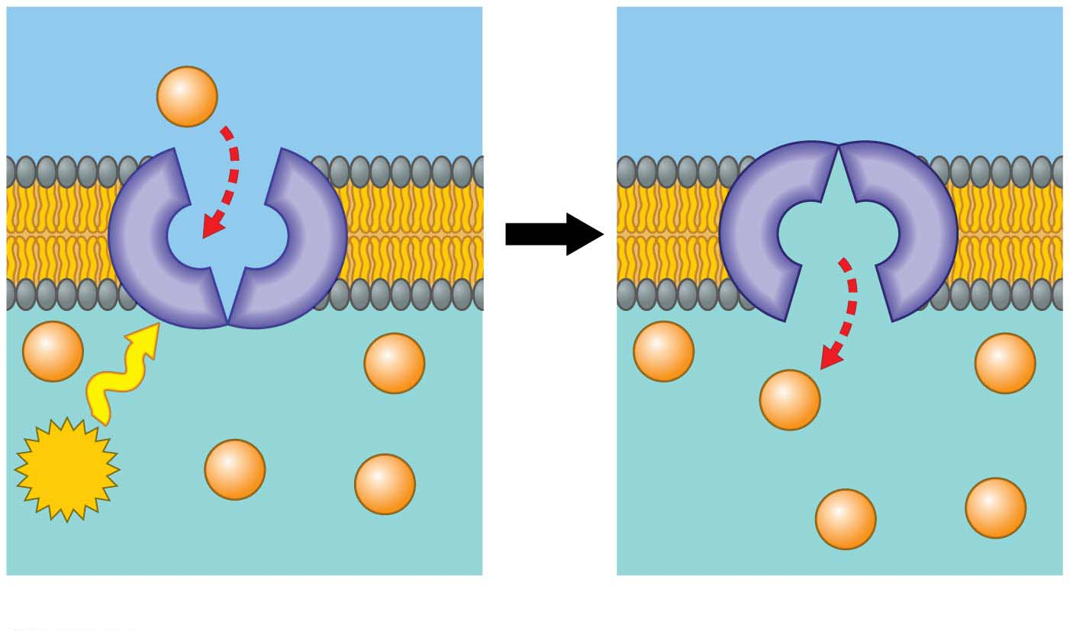
Active Transport능동수송: The Pumping of Molecules across Membranes
Active transport requires that a cell expend energy to move molecules across a membrane.
Cellular energy (usually provided by ATP) is used to drive a transport protein that pumps a solute against the concentration gradient.
Active transport allows cells to maintain internal concentrations of small solutes that differ from environmental concentrations.
Notes:
23
Student Misconceptions and Concerns
1. For students with limited science backgrounds, concepts such as diffusion and osmosis can take considerable time to fully understand and apply. Instructors often struggle to remember a time in their lives when they did not know about such fundamental scientific principles. Consider spending extra time to illustrate and demonstrate these key processes to the class. Consider short interactive class exercises in which students create analogies or think of examples of these principles in their lives.
2. Students easily confuse the terms hypertonic and hypotonic. One challenge is to understand that these are relative terms, such as heavier, darker, or fewer. No single solution is “heavier,” no single cup of coffee is “darker,” and no single bag of M & M’s has “fewer” candies. Such terms only apply when comparing two or more items. A solution with a higher concentration is “hypertonic.” But the same solution might also be “hypotonic” to a third solution.
Teaching Tips
1. Students often benefit from reminders of diffusion in their lives. Smells can usually be traced back to their sources—the smell of dinner on the stove, the scent of a perfume or cologne coming from its bottle, the smoke drifting away from a campfire. These scents are strongest nearest the source and weaker as we move away.
2. The word root “hypo” means “below.” Thus, a hypodermic needle injects substances below the dermis. Students might best remember that hypotonic solutions have concentrations below that of the other solution(s).
3. After introducing the idea of hypertonic and hypotonic solutions, you may wish to challenge your students with the following: A marine salmon moves from the ocean up a freshwater stream to reproduce. The salmon is moving from a _____ environment to a _____ environment. (Answers: hypertonic; hypotonic)
4. Your students may have noticed that their fingers wrinkle after taking a long shower or bath or washing dishes. The skin wrinkles because it is swollen with water but still tacked down at some points. Oils inhibit the movement of water into our skin. Thus, soapy water results in wrinkling faster than plain water since the soap removes the natural layer of oil from our skin. Our skin is hypertonic to the solutions that produce the swelling that appears as large wrinkles.
5. The effects of hypertonic and hypotonic solutions are easily demonstrated if students soak carrot sticks, long slices of potato, or celery in hypertonic and hypotonic solutions. These also make nice class demonstrations.
6. The hydrophobic and hydrophilic ends of a phospholipid molecule create a lipid bilayer. The hydrophobic edges of the layer will also seal to other such edges, eventually wrapping a sheet into a sphere that can enclose water. Furthermore, because of these hydrophobic properties, lipid bilayers are naturally self-healing. All of these properties emerge from the structure of phospholipid.
Active Lecture Tips
1. Consider demonstrating simple diffusion. A large jar of water and a few drops of dark-colored dye work well over the course of a lecture period. Alternatively, release a strong scent of cologne or peppermint or peel part of an orange in the classroom and have students raise their hands as they first detect the smell. Students nearest the source will raise their hands before students farther away. A fan from a projector or overhead vent may bias the experiment a bit, so be aware of any directed movements of air in your classroom that might disrupt this demonstration.
2. See the Activity Using Food and Drink to Describe Osmosis on the Instructor Exchange. Visit the Instructor Exchange in the MasteringBiology instructor resource area for a description of this activity.
3. Students carefully considering exocytosis may notice that membrane from secretory vesicles is added to the plasma membrane. Challenge your students to work with someone sitting nearby to identify mechanisms that balance out this enlargement of the cell surface. (Endocytosis “subtracts” area from the cell surface. It is a major factor balancing out the additional membrane supplied by exocytosis.)

Slide 24
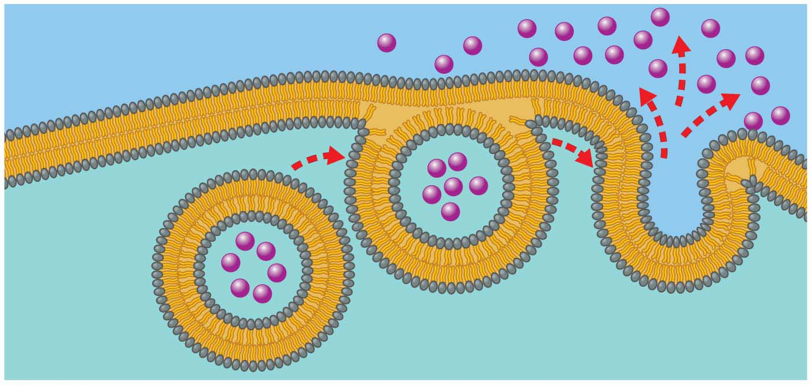
Exocytosis and Endocytosis: Traffic of Large Molecules
Exocytosis세포외유출 is the movement of materials out of the cytoplasm of a cell via membranous vesicles or vacuoles that fuse with the plasma membrane.
Plasma
membrane
Cytoplasm
Molecule to be exported
Notes:
24
Student Misconceptions and Concerns
1. For students with limited science backgrounds, concepts such as diffusion and osmosis can take considerable time to fully understand and apply. Instructors often struggle to remember a time in their lives when they did not know about such fundamental scientific principles. Consider spending extra time to illustrate and demonstrate these key processes to the class. Consider short interactive class exercises in which students create analogies or think of examples of these principles in their lives.
2. Students easily confuse the terms hypertonic and hypotonic. One challenge is to understand that these are relative terms, such as heavier, darker, or fewer. No single solution is “heavier,” no single cup of coffee is “darker,” and no single bag of M & M’s has “fewer” candies. Such terms only apply when comparing two or more items. A solution with a higher concentration is “hypertonic.” But the same solution might also be “hypotonic” to a third solution.
Teaching Tips
1. Students often benefit from reminders of diffusion in their lives. Smells can usually be traced back to their sources—the smell of dinner on the stove, the scent of a perfume or cologne coming from its bottle, the smoke drifting away from a campfire. These scents are strongest nearest the source and weaker as we move away.
2. The word root “hypo” means “below.” Thus, a hypodermic needle injects substances below the dermis. Students might best remember that hypotonic solutions have concentrations below that of the other solution(s).
3. After introducing the idea of hypertonic and hypotonic solutions, you may wish to challenge your students with the following: A marine salmon moves from the ocean up a freshwater stream to reproduce. The salmon is moving from a _____ environment to a _____ environment. (Answers: hypertonic; hypotonic)
4. Your students may have noticed that their fingers wrinkle after taking a long shower or bath or washing dishes. The skin wrinkles because it is swollen with water but still tacked down at some points. Oils inhibit the movement of water into our skin. Thus, soapy water results in wrinkling faster than plain water since the soap removes the natural layer of oil from our skin. Our skin is hypertonic to the solutions that produce the swelling that appears as large wrinkles.
5. The effects of hypertonic and hypotonic solutions are easily demonstrated if students soak carrot sticks, long slices of potato, or celery in hypertonic and hypotonic solutions. These also make nice class demonstrations.
6. The hydrophobic and hydrophilic ends of a phospholipid molecule create a lipid bilayer. The hydrophobic edges of the layer will also seal to other such edges, eventually wrapping a sheet into a sphere that can enclose water. Furthermore, because of these hydrophobic properties, lipid bilayers are naturally self-healing. All of these properties emerge from the structure of phospholipid.
Active Lecture Tips
1. Consider demonstrating simple diffusion. A large jar of water and a few drops of dark-colored dye work well over the course of a lecture period. Alternatively, release a strong scent of cologne or peppermint or peel part of an orange in the classroom and have students raise their hands as they first detect the smell. Students nearest the source will raise their hands before students farther away. A fan from a projector or overhead vent may bias the experiment a bit, so be aware of any directed movements of air in your classroom that might disrupt this demonstration.
2. See the Activity Using Food and Drink to Describe Osmosis on the Instructor Exchange. Visit the Instructor Exchange in the MasteringBiology instructor resource area for a description of this activity.
3. Students carefully considering exocytosis may notice that membrane from secretory vesicles is added to the plasma membrane. Challenge your students to work with someone sitting nearby to identify mechanisms that balance out this enlargement of the cell surface. (Endocytosis “subtracts” area from the cell surface. It is a major factor balancing out the additional membrane supplied by exocytosis.)

Slide 25
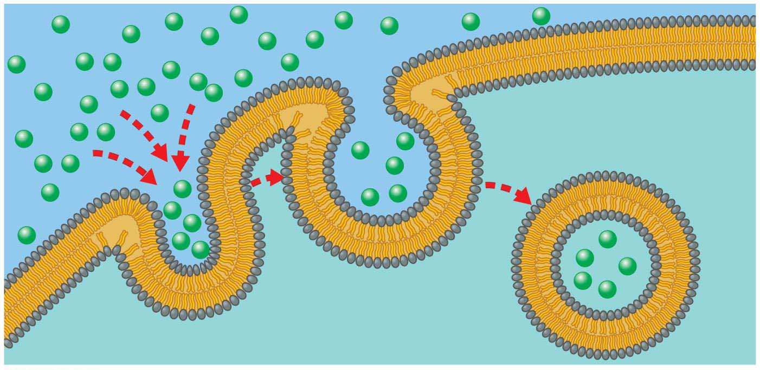
In endocytosis내포작용, a cell takes material in via vesicles that bud inward.
For example, in a process called phagocytosis 식세포작용 (“cellular eating”), a cell engulfs a particle and packages it within a food vacuole.
Notes:
25
Student Misconceptions and Concerns
1. For students with limited science backgrounds, concepts such as diffusion and osmosis can take considerable time to fully understand and apply. Instructors often struggle to remember a time in their lives when they did not know about such fundamental scientific principles. Consider spending extra time to illustrate and demonstrate these key processes to the class. Consider short interactive class exercises in which students create analogies or think of examples of these principles in their lives.
2. Students easily confuse the terms hypertonic and hypotonic. One challenge is to understand that these are relative terms, such as heavier, darker, or fewer. No single solution is “heavier,” no single cup of coffee is “darker,” and no single bag of M & M’s has “fewer” candies. Such terms only apply when comparing two or more items. A solution with a higher concentration is “hypertonic.” But the same solution might also be “hypotonic” to a third solution.
Teaching Tips
1. Students often benefit from reminders of diffusion in their lives. Smells can usually be traced back to their sources—the smell of dinner on the stove, the scent of a perfume or cologne coming from its bottle, the smoke drifting away from a campfire. These scents are strongest nearest the source and weaker as we move away.
2. The word root “hypo” means “below.” Thus, a hypodermic needle injects substances below the dermis. Students might best remember that hypotonic solutions have concentrations below that of the other solution(s).
3. After introducing the idea of hypertonic and hypotonic solutions, you may wish to challenge your students with the following: A marine salmon moves from the ocean up a freshwater stream to reproduce. The salmon is moving from a _____ environment to a _____ environment. (Answers: hypertonic; hypotonic)
4. Your students may have noticed that their fingers wrinkle after taking a long shower or bath or washing dishes. The skin wrinkles because it is swollen with water but still tacked down at some points. Oils inhibit the movement of water into our skin. Thus, soapy water results in wrinkling faster than plain water since the soap removes the natural layer of oil from our skin. Our skin is hypertonic to the solutions that produce the swelling that appears as large wrinkles.
5. The effects of hypertonic and hypotonic solutions are easily demonstrated if students soak carrot sticks, long slices of potato, or celery in hypertonic and hypotonic solutions. These also make nice class demonstrations.
6. The hydrophobic and hydrophilic ends of a phospholipid molecule create a lipid bilayer. The hydrophobic edges of the layer will also seal to other such edges, eventually wrapping a sheet into a sphere that can enclose water. Furthermore, because of these hydrophobic properties, lipid bilayers are naturally self-healing. All of these properties emerge from the structure of phospholipid.
Active Lecture Tips
1. Consider demonstrating simple diffusion. A large jar of water and a few drops of dark-colored dye work well over the course of a lecture period. Alternatively, release a strong scent of cologne or peppermint or peel part of an orange in the classroom and have students raise their hands as they first detect the smell. Students nearest the source will raise their hands before students farther away. A fan from a projector or overhead vent may bias the experiment a bit, so be aware of any directed movements of air in your classroom that might disrupt this demonstration.
2. See the Activity Using Food and Drink to Describe Osmosis on the Instructor Exchange. Visit the Instructor Exchange in the MasteringBiology instructor resource area for a description of this activity.
3. Students carefully considering exocytosis may notice that membrane from secretory vesicles is added to the plasma membrane. Challenge your students to work with someone sitting nearby to identify mechanisms that balance out this enlargement of the cell surface. (Endocytosis “subtracts” area from the cell surface. It is a major factor balancing out the additional membrane supplied by exocytosis.)

Slide 26
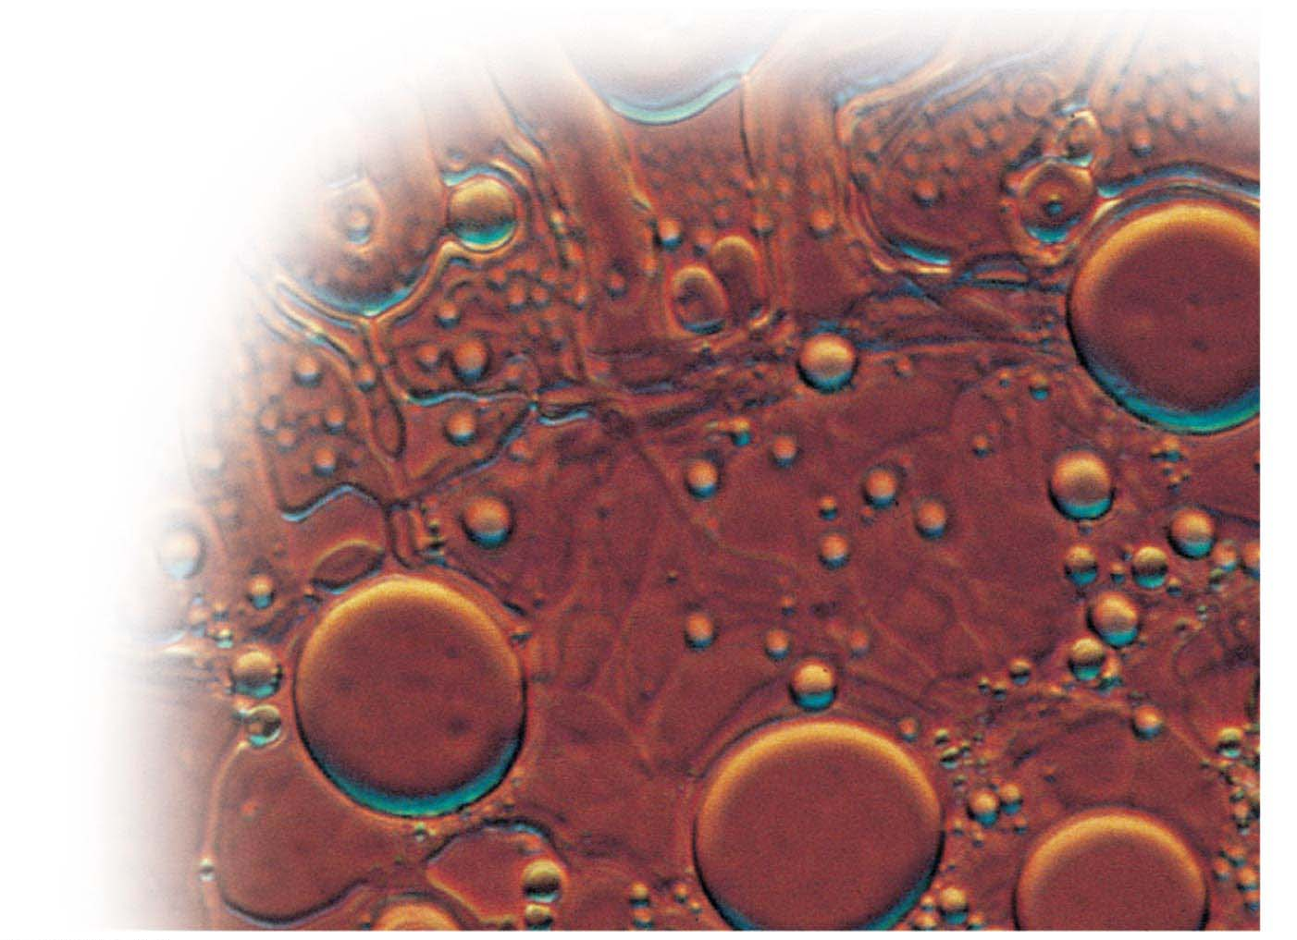
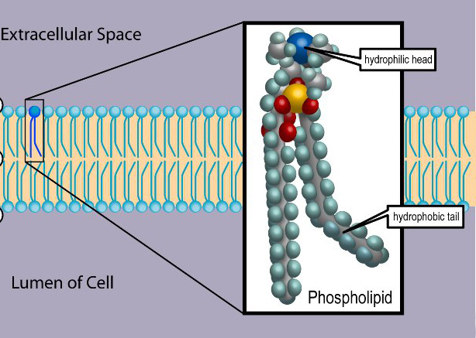
Evolution Connection: The Origin of Membranes
Phospholipids인지질
are key ingredients of membranes,
were probably among the first organic compounds that formed from chemical reactions on early Earth, and self-assemble into simple membranes.
Water-filled
bubble made of
phospholipids
Notes:
26
Student Misconceptions and Concerns
1. For students with limited science backgrounds, concepts such as diffusion and osmosis can take considerable time to fully understand and apply. Instructors often struggle to remember a time in their lives when they did not know about such fundamental scientific principles. Consider spending extra time to illustrate and demonstrate these key processes to the class. Consider short interactive class exercises in which students create analogies or think of examples of these principles in their lives.
2. Students easily confuse the terms hypertonic and hypotonic. One challenge is to understand that these are relative terms, such as heavier, darker, or fewer. No single solution is “heavier,” no single cup of coffee is “darker,” and no single bag of M & M’s has “fewer” candies. Such terms only apply when comparing two or more items. A solution with a higher concentration is “hypertonic.” But the same solution might also be “hypotonic” to a third solution.
Teaching Tips
1. Students often benefit from reminders of diffusion in their lives. Smells can usually be traced back to their sources—the smell of dinner on the stove, the scent of a perfume or cologne coming from its bottle, the smoke drifting away from a campfire. These scents are strongest nearest the source and weaker as we move away.
2. The word root “hypo” means “below.” Thus, a hypodermic needle injects substances below the dermis. Students might best remember that hypotonic solutions have concentrations below that of the other solution(s).
3. After introducing the idea of hypertonic and hypotonic solutions, you may wish to challenge your students with the following: A marine salmon moves from the ocean up a freshwater stream to reproduce. The salmon is moving from a _____ environment to a _____ environment. (Answers: hypertonic; hypotonic)
4. Your students may have noticed that their fingers wrinkle after taking a long shower or bath or washing dishes. The skin wrinkles because it is swollen with water but still tacked down at some points. Oils inhibit the movement of water into our skin. Thus, soapy water results in wrinkling faster than plain water since the soap removes the natural layer of oil from our skin. Our skin is hypertonic to the solutions that produce the swelling that appears as large wrinkles.
5. The effects of hypertonic and hypotonic solutions are easily demonstrated if students soak carrot sticks, long slices of potato, or celery in hypertonic and hypotonic solutions. These also make nice class demonstrations.
6. The hydrophobic and hydrophilic ends of a phospholipid molecule create a lipid bilayer. The hydrophobic edges of the layer will also seal to other such edges, eventually wrapping a sheet into a sphere that can enclose water. Furthermore, because of these hydrophobic properties, lipid bilayers are naturally self-healing. All of these properties emerge from the structure of phospholipid.
Active Lecture Tips
1. Consider demonstrating simple diffusion. A large jar of water and a few drops of dark-colored dye work well over the course of a lecture period. Alternatively, release a strong scent of cologne or peppermint or peel part of an orange in the classroom and have students raise their hands as they first detect the smell. Students nearest the source will raise their hands before students farther away. A fan from a projector or overhead vent may bias the experiment a bit, so be aware of any directed movements of air in your classroom that might disrupt this demonstration.
2. See the Activity Using Food and Drink to Describe Osmosis on the Instructor Exchange. Visit the Instructor Exchange in the MasteringBiology instructor resource area for a description of this activity.
3. Students carefully considering exocytosis may notice that membrane from secretory vesicles is added to the plasma membrane. Challenge your students to work with someone sitting nearby to identify mechanisms that balance out this enlargement of the cell surface. (Endocytosis “subtracts” area from the cell surface. It is a major factor balancing out the additional membrane supplied by exocytosis.)

